Slide 1
StarScream
From starlight to soundwaves!
Rayman Jamal
Jaydeep Mistry
Jonathan Ong
Tochi Oramasionwu
Space Apps Challenge 2023

Slide 2
Challenge: Immersed in the Sounds of Space
“Your challenge is to design a method to create sonifications of 3D NASA space datasets.”
Team StarScream accomplished this by creating a process to generate an audio track from fly-through frames
The end result is a video that stimulates both visual and auditory senses
Notes:
Space exploration has predominantly been enjoyed through visual means

Slide 3
Challenge Accepted: Project Cosmic Harmony
An audio/visual trip through space
Why?
Space is awe-inspiring and, beyond all else, we are excited to provide a unique way for everyone to appreciate its beauty.
By adding this new audio layer to visual data, we aim to inspire others, including those who are visually impaired, to enjoy the stars.

Slide 4
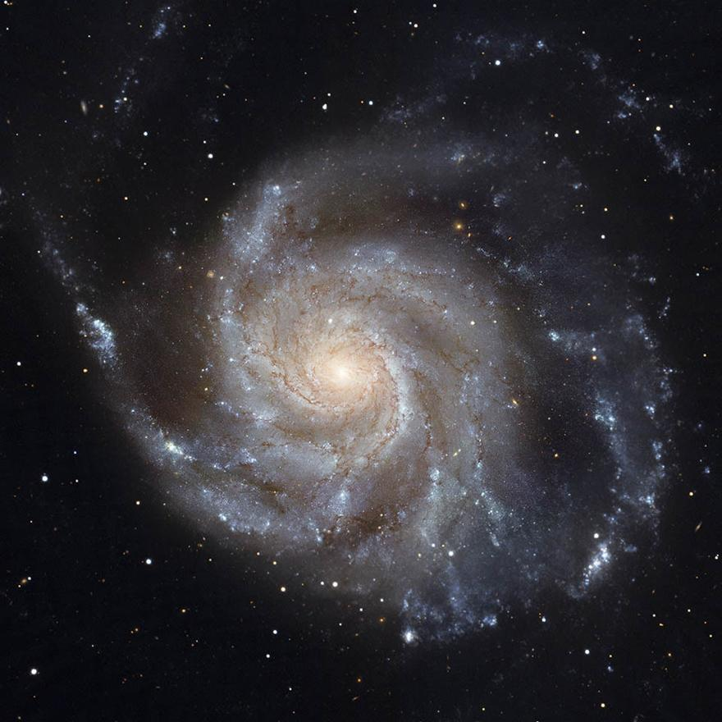
How it works
L
CL
C
CR
R
Split each NASA fly-through photo into 5x5 grids
Summarize each square of grid based on average colours of each pixel
Convert squares into MIDI tracks
Merge MIDI tracks together to produce audio track
Stitch images together alongside audio to produce fly-through sonification

Slide 5
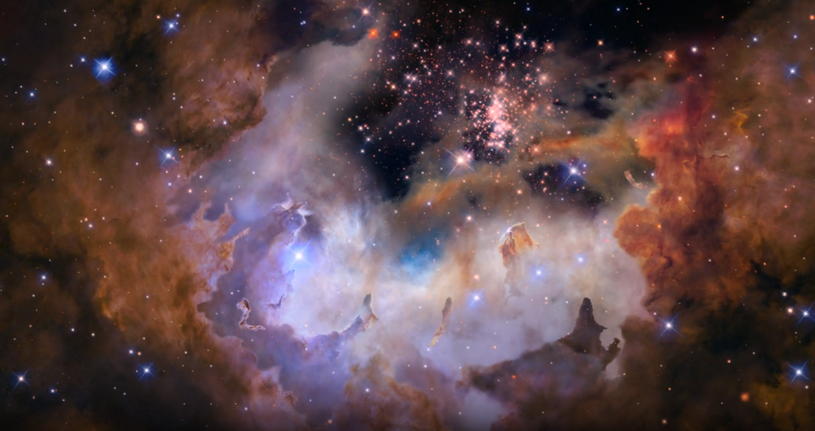
Product Demo
Video link: https://spaceapps2023.rrjamal.ca/videos/output_video_westerlund2_1920x1080_30fps.mp4
See more!
https://spaceapps2023.rrjamal.ca/sonifications

Slide 6
Looking to the future
As this project grows, we are excited to anticipate what can come next!
Some future ideas:
VR implementation, possibly enabling user controls, to enhance overall experience
Research ways to stimulate more senses, such as touch, while watching fly-through videos
Cloud support to allow users to provide their own datasets for fly-through sonification
Direct integration with NASA data suppliers to auto-generate sonifications of new data
Receive feedback from visually impaired audience to cater a more engaging experience
Identify enhancements that can be made to core algorithm, producing higher quality media

